Slide 1
The following few slides can be shown to your class.
This slideshow is designed to help prepare the children for your trip, and hopefully get them excited for the visit!
Please feel free to edit the slides to suit the needs of your class.

Slide 2
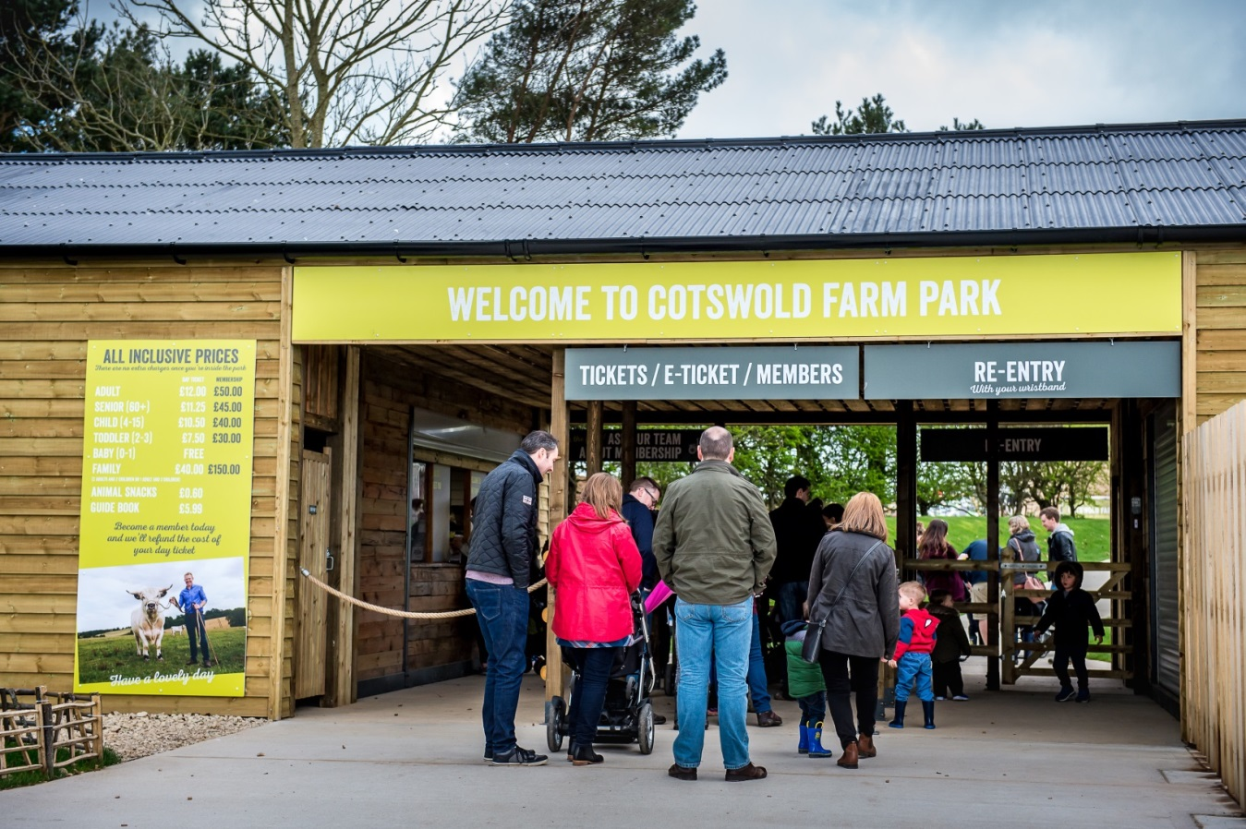
We’re going on a trip to…

Slide 3
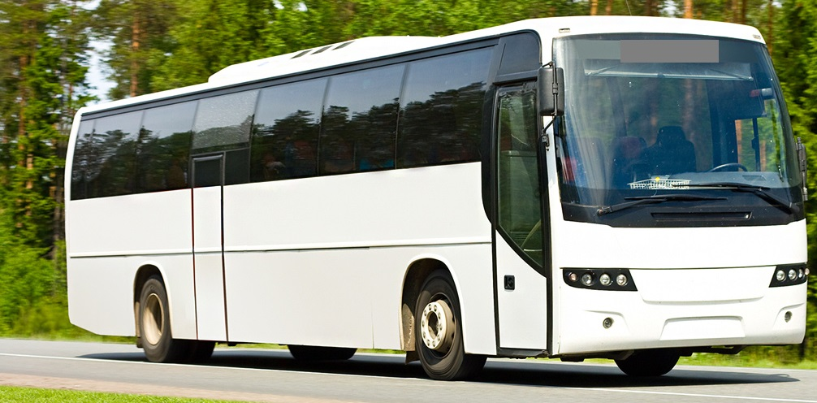
Soon you will be visiting Cotswold Farm Park
You may travel by coach in order to get there.
Have you been on a coach before?

Slide 4
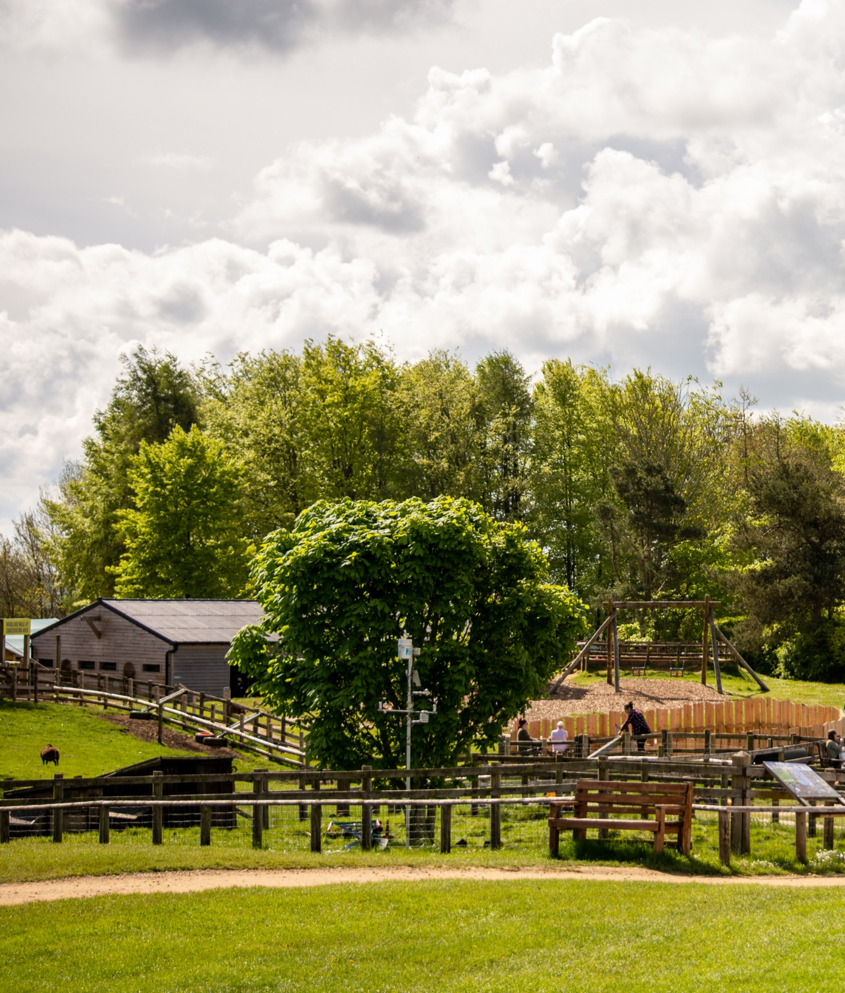
You will arrive in the countryside.
Have you been to the countryside before?

Slide 5
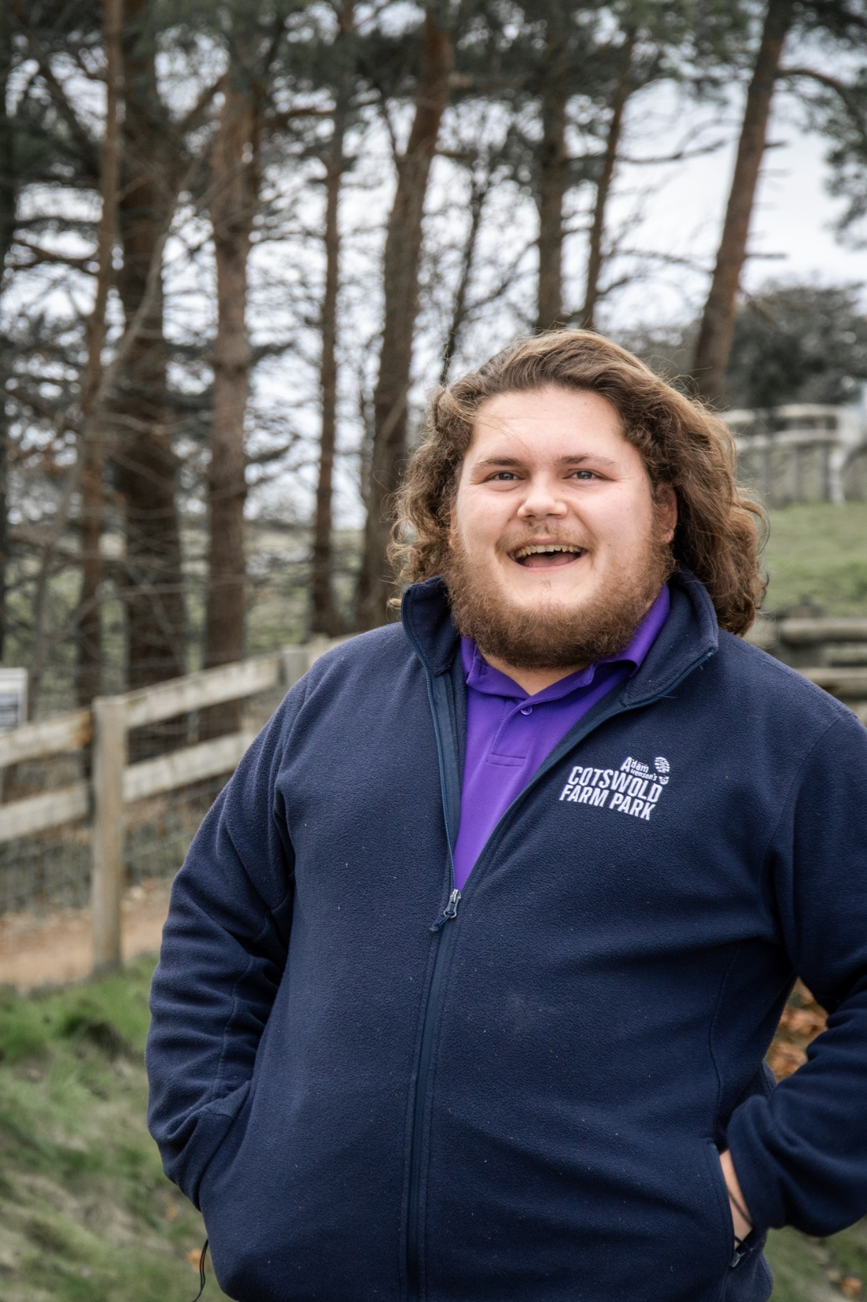
After a quick stop at the toilets, the friendly team will share some important information about how to stay safe on the farm.
Remember to listen carefully!

Slide 6
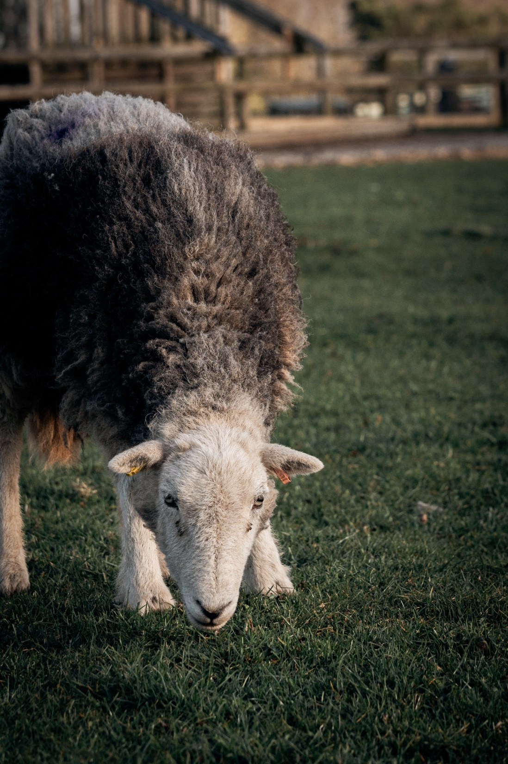
While you are at the farm, you will get to meet lots of animals.
What animals do you think you will meet?

Slide 7
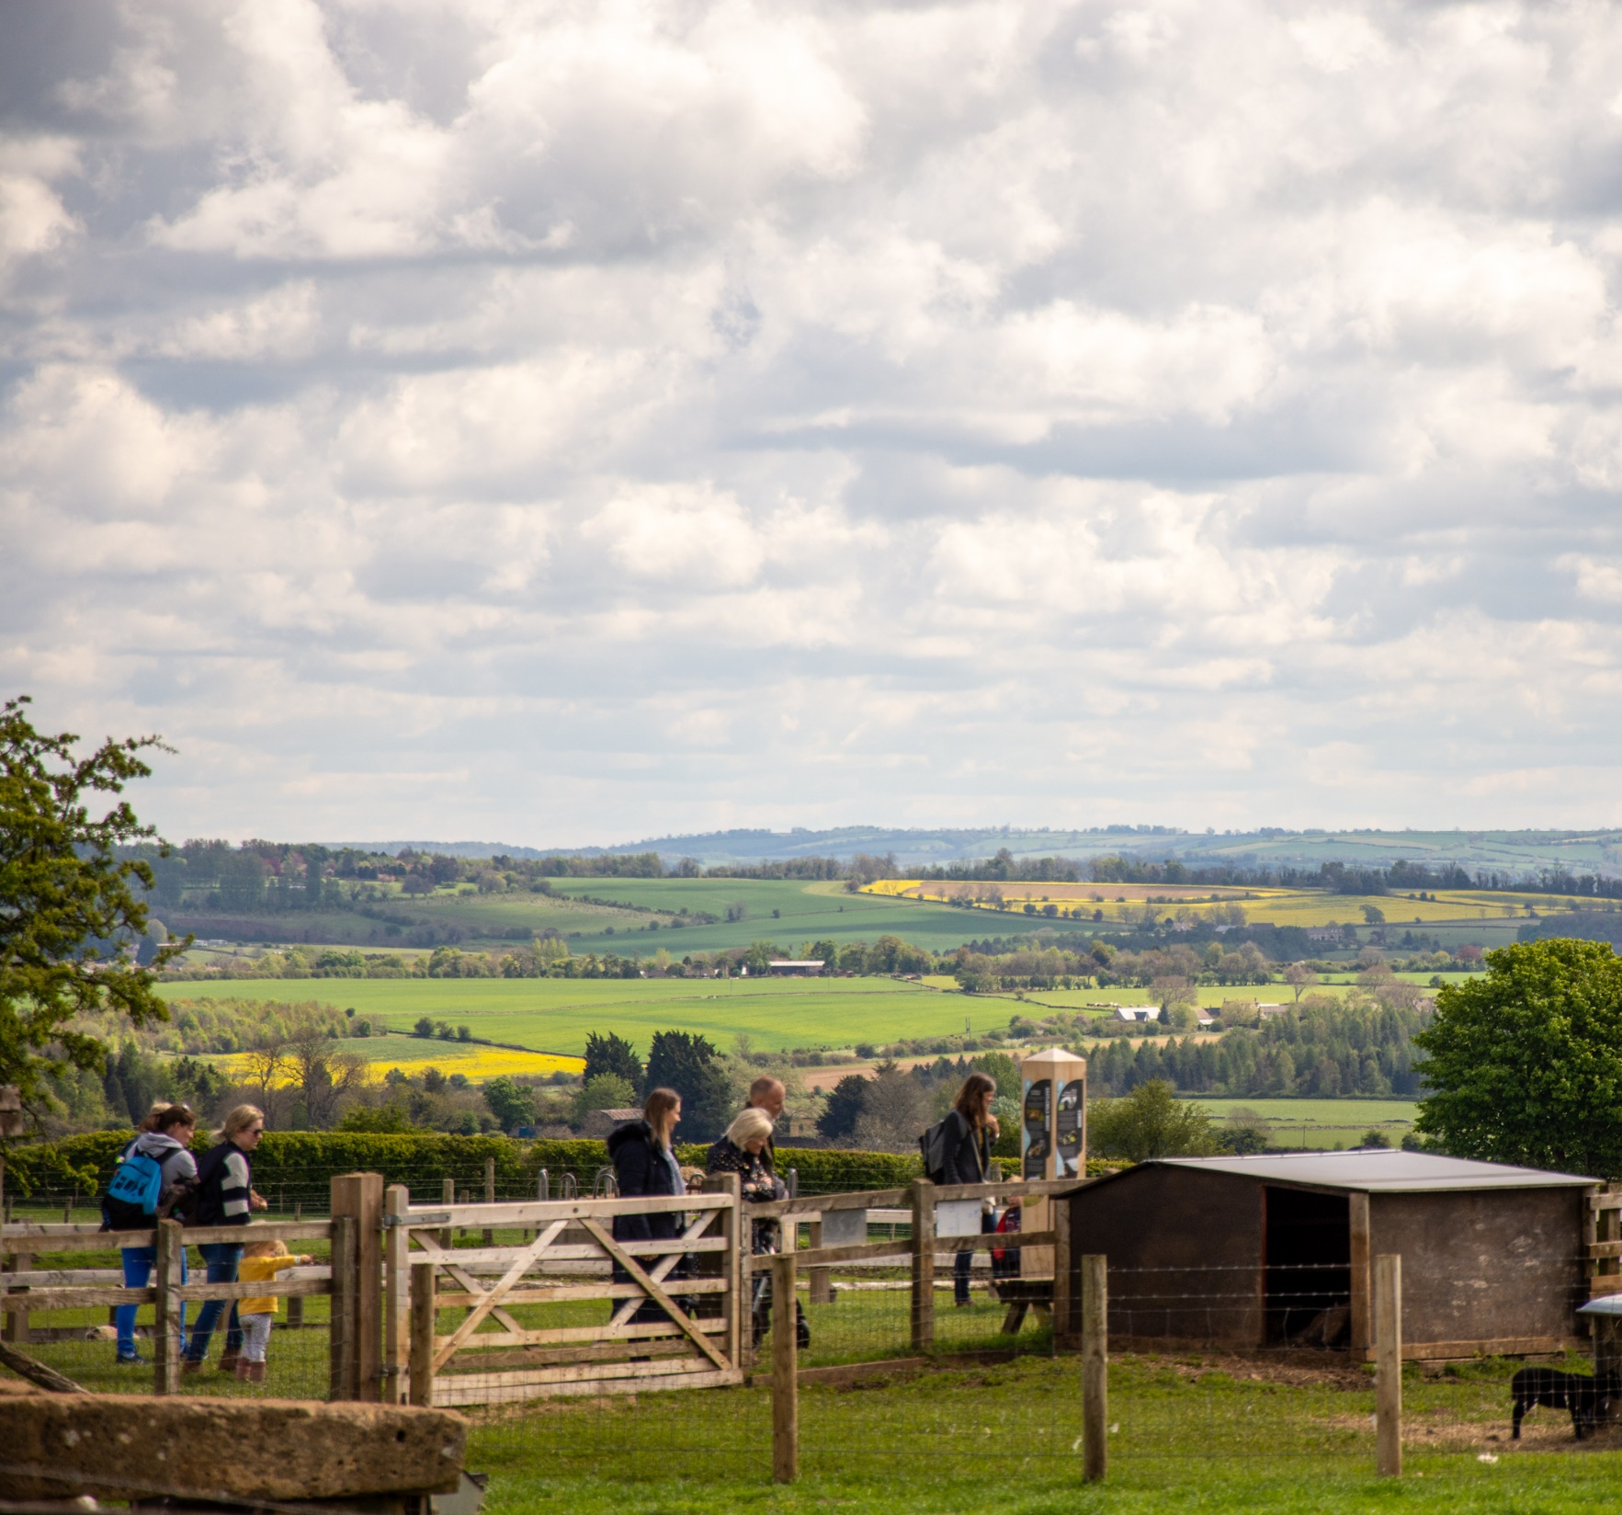
When you are at Cotswold Farm Park, you will do different activities.
You will meet lots of animals and learn about the farm!

Slide 8
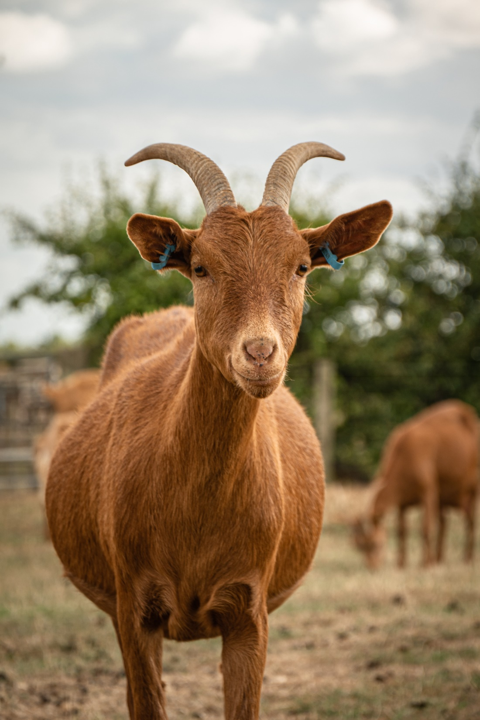
You will meet some the animals on the farm
With some of the smaller animals, you might even be able to hold and stroke them, they are very friendly!
You can also ask some questions about the animals.
What kind of things would you like to find out about our animals on the farm?

Slide 9
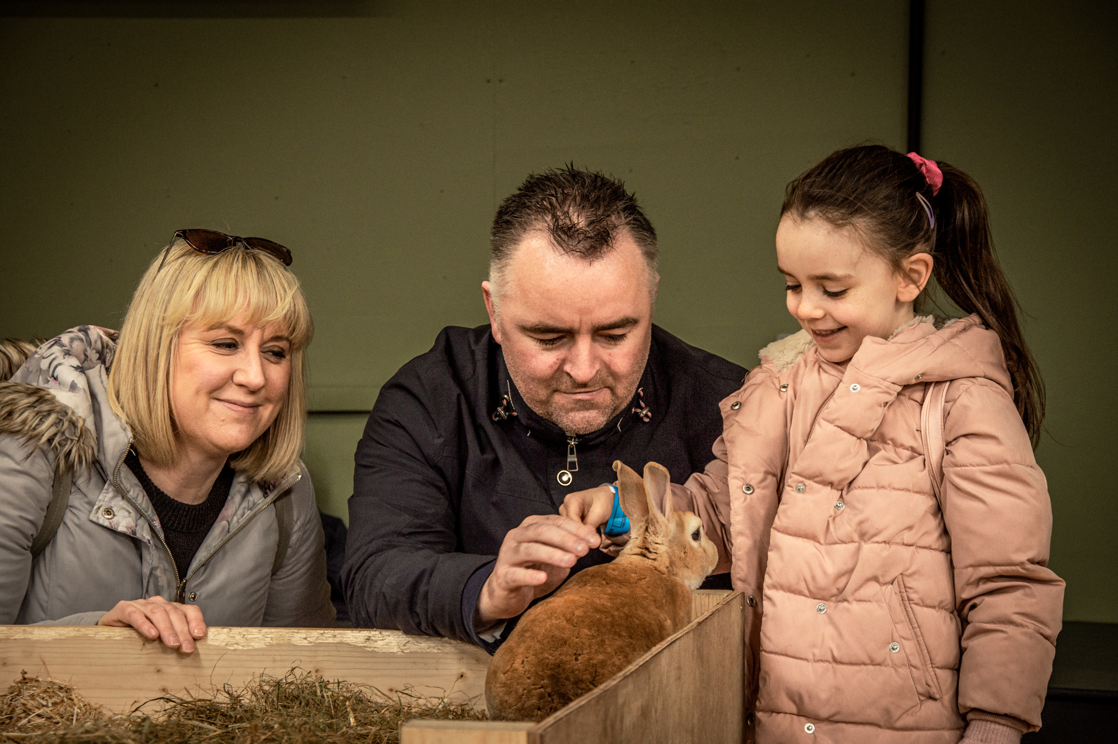
Have you held any animals before?
What should you remember when you’re holding an animal?

Slide 10
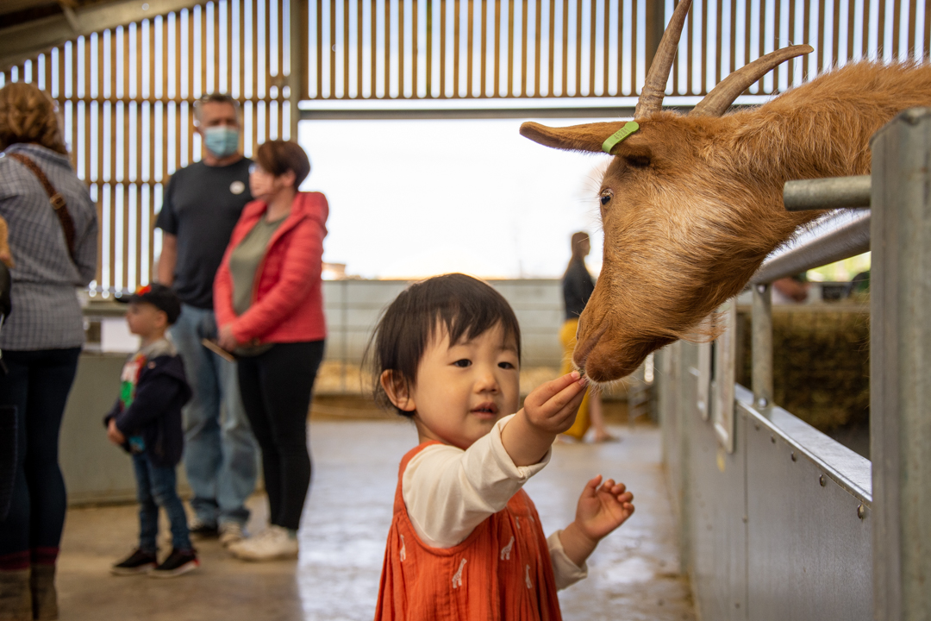
You will visit the barns
Remember to talk quietly, so you can see the animals settled in their homes

Slide 11
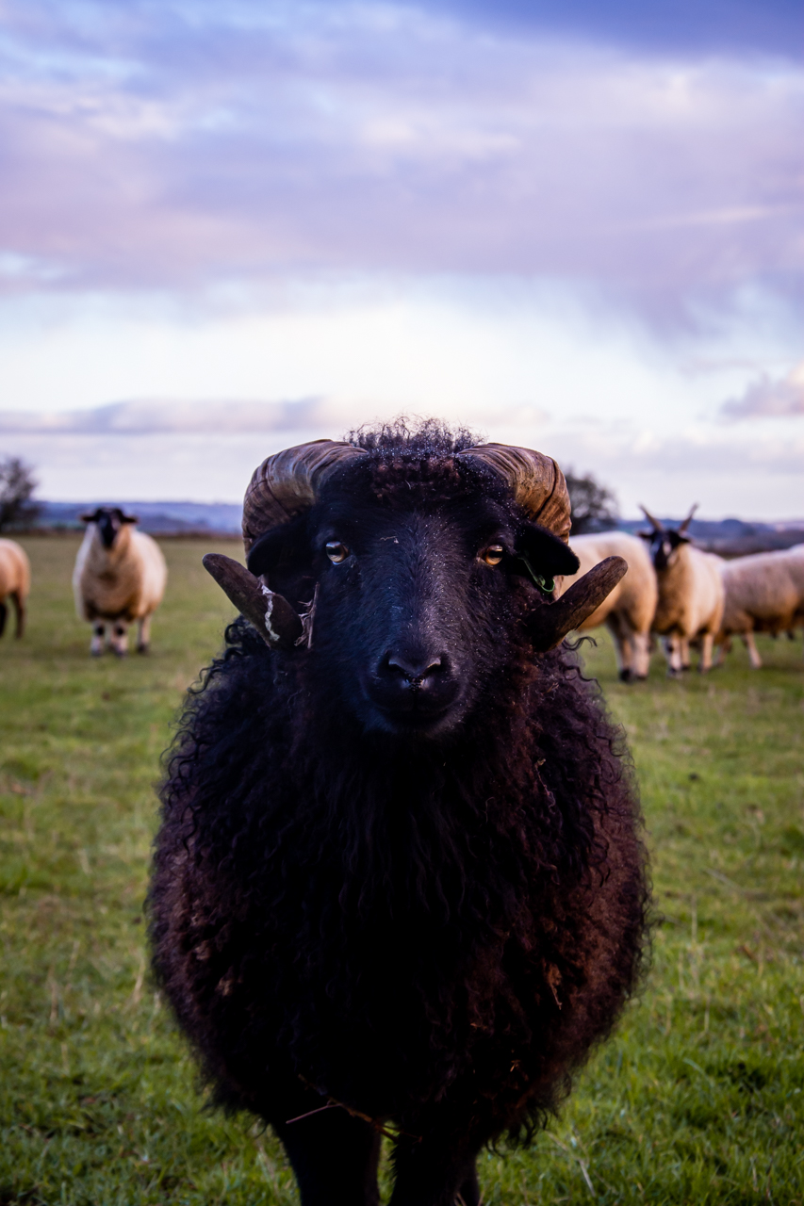
Explore the rare breed walkway
Our animals are fed special diets. You can feed the sheep and goats the animal snacks, but please make sure they don’t get give them any extra food as it can make them feel unwell.
Let’s take part in an activity! How many different types of animal can you see on the walkway? Can you spot them all?

Slide 12
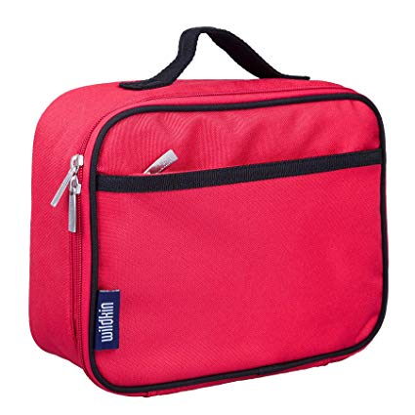
At lunch time
You will bring a packed lunch with you to the farm. Make sure you use a bin to help keep the farm tidy.
Why is it important to put your litter in a bin on the farm?

Slide 13
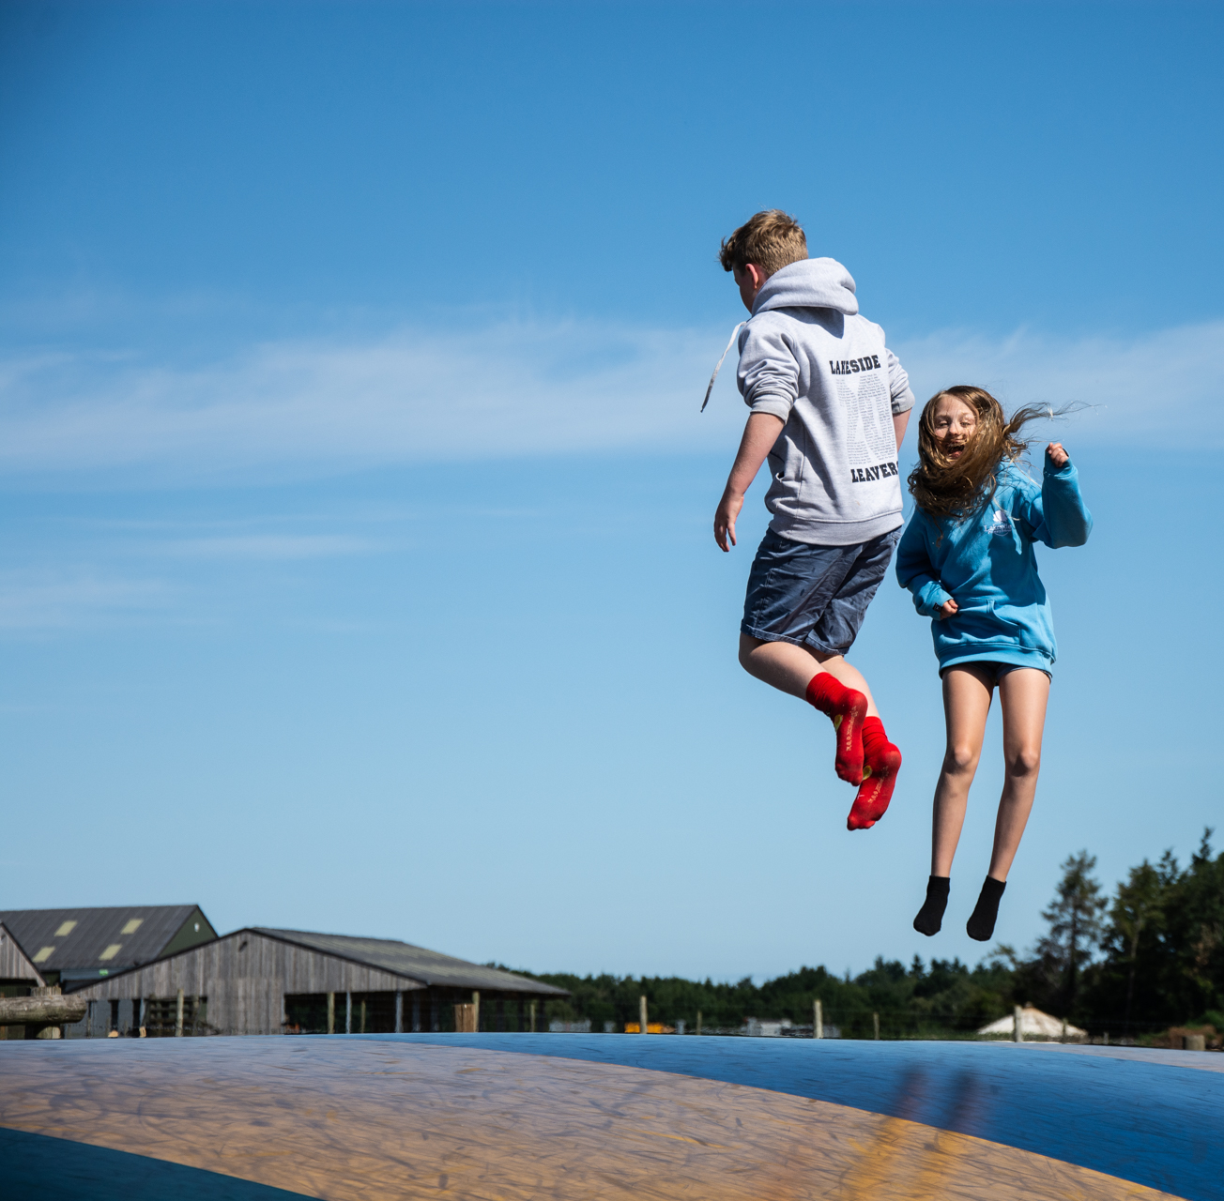
Play time!
As well as meeting the animals, there might also be time for play at the farm!

Slide 14
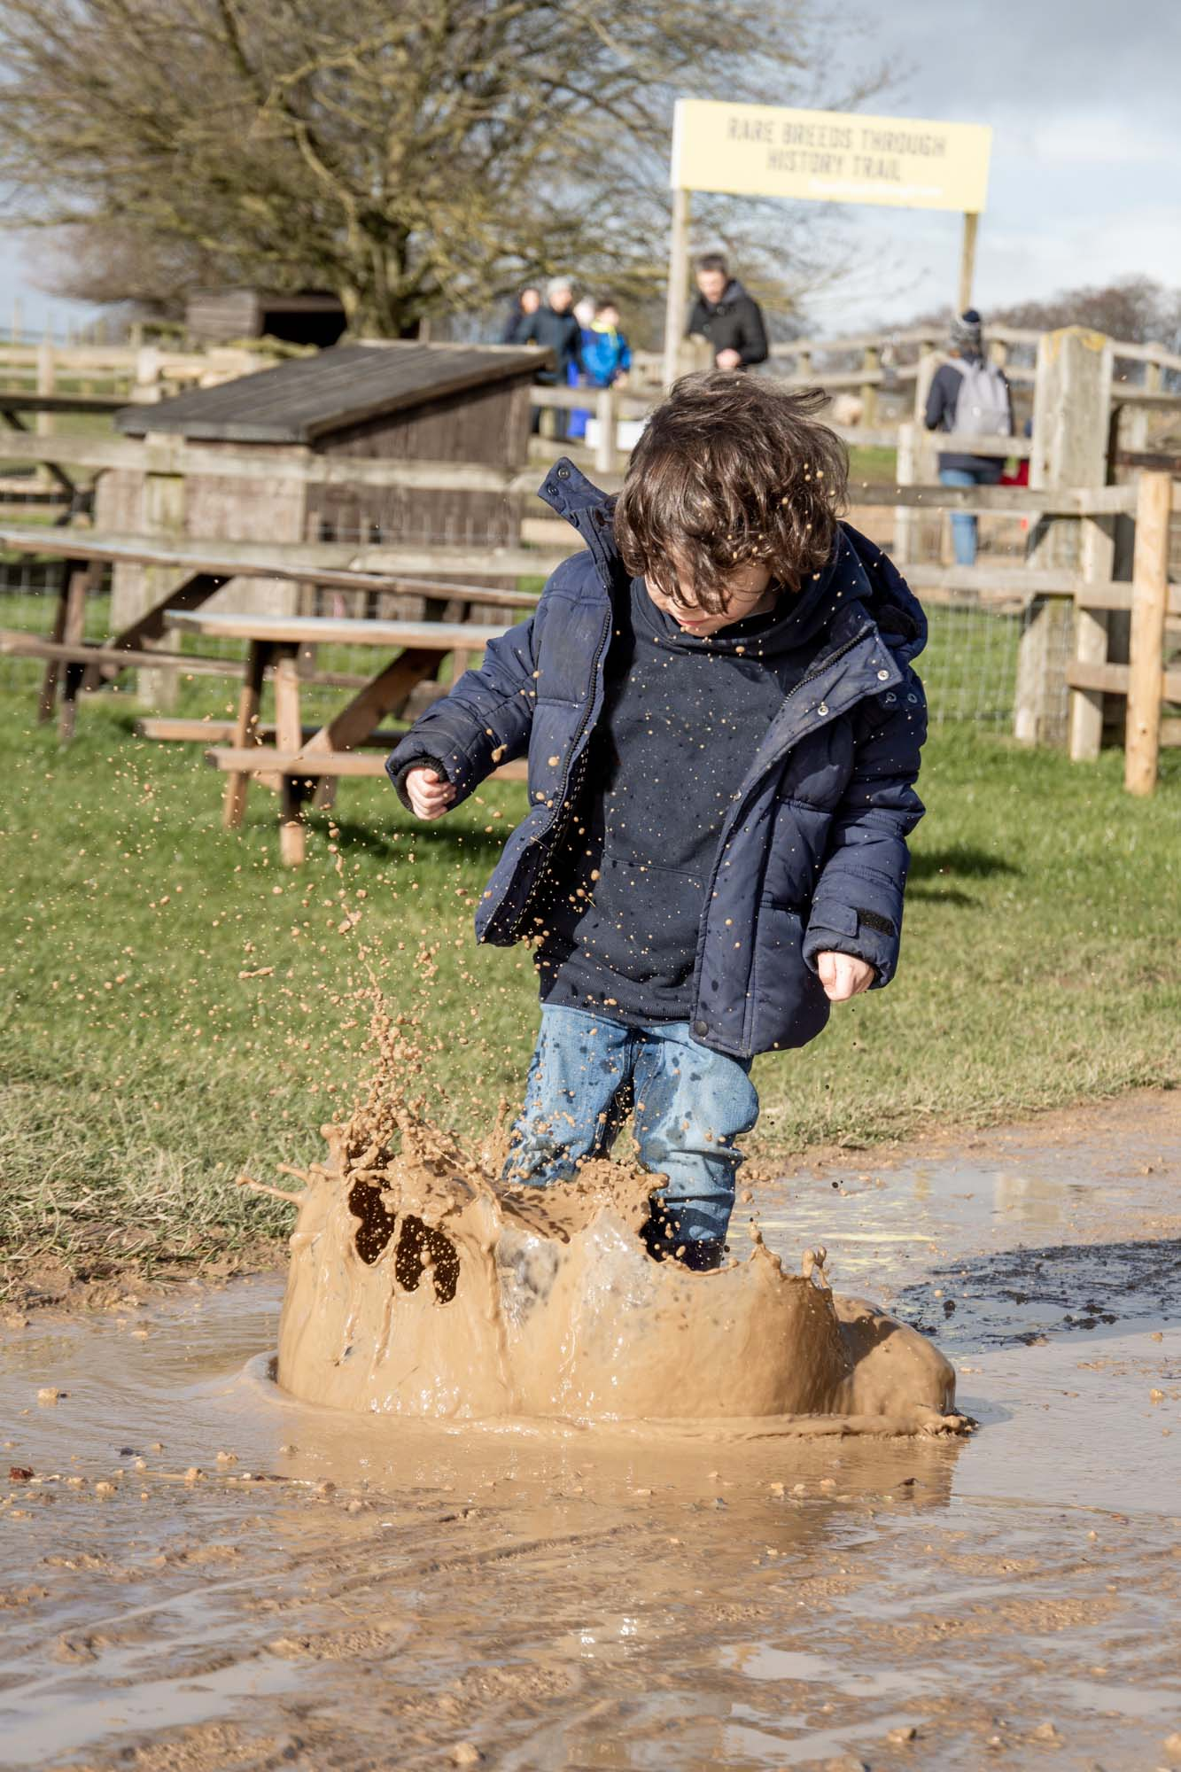
What if it rains?
It’s not always sunny at Cotswold Farm Park, but the animals don’t mind!
Make sure you have the right shoes and clothing for your visit if the weather is going to be wet.

Slide 15
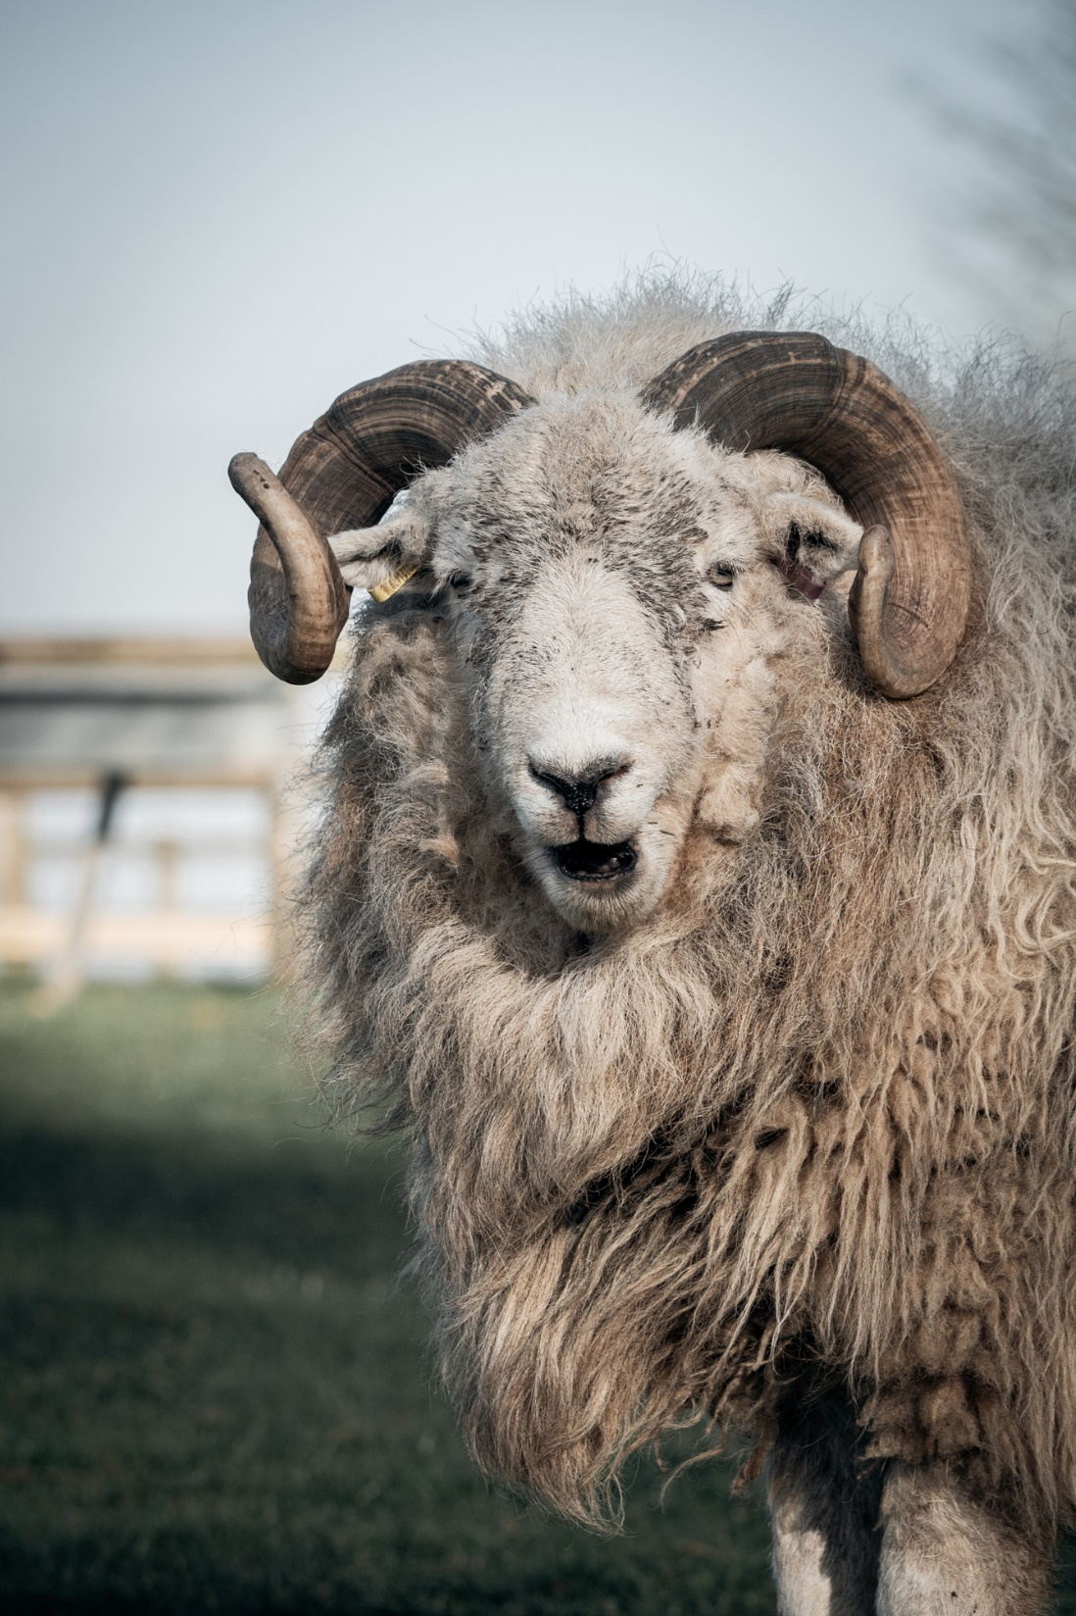
Remember to wash your hands
After touching, feeding or being near our friendly farm animals, it’s important to wash your hands.
There are plenty of places around the park to wash your hands so you won’t forget!

Slide 16
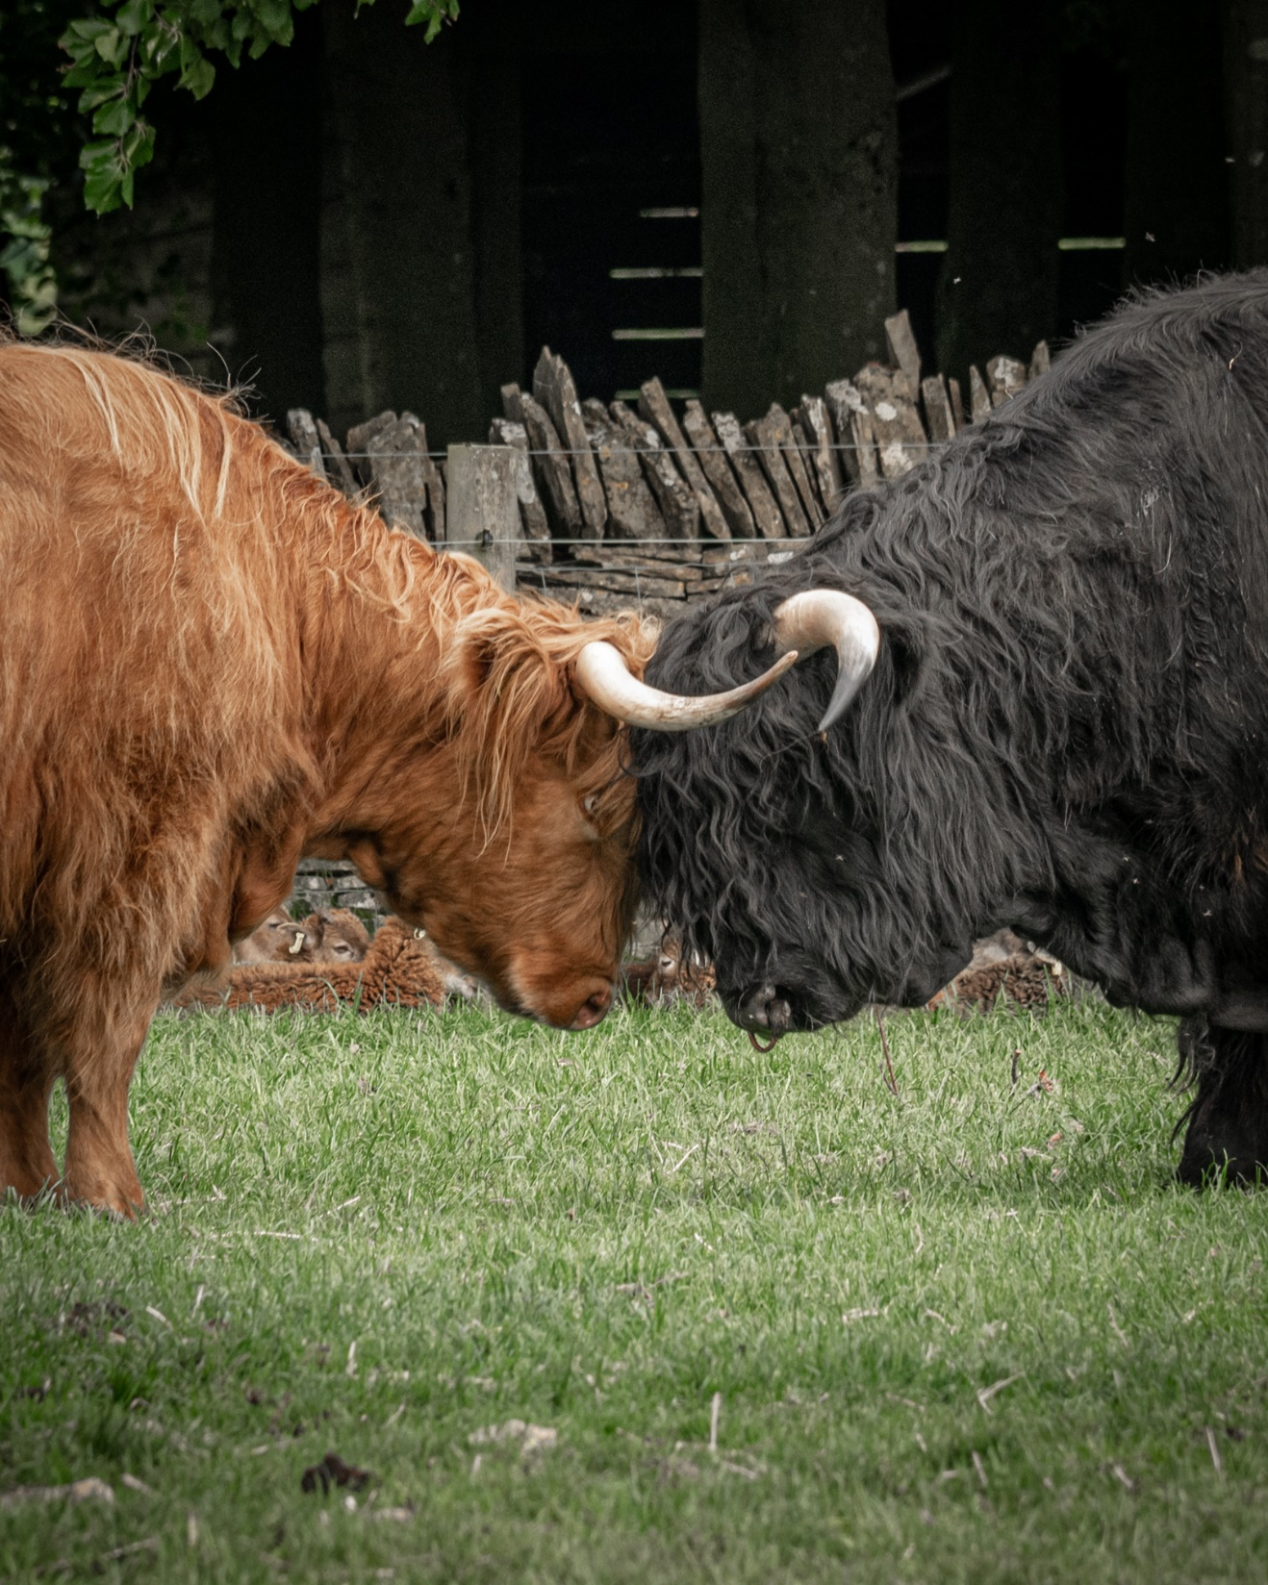
Who are you looking forward to seeing most?
Rabbits?
Sheep?
Pigs?
Goats?
Cows?
Donkeys?
Horses?
Something else?

Slide 17
End of content for children

Slide 18
After your visit…
We hope both you and your group enjoy your visit to The Cotswold Farm Park.
If you need to get in touch or have any feedback about your trip, then please email us at: hello@cotswoldfarmpark.co.uk
Remember to have a look on our website for free learning resources to do before or after your trip! We’ve partnered with Explorify to create some exciting free activities at www.explorify.uk - where you’ll also find lots of other interesting activities. This is a FREE resource for schools.

Slide 19
Watch & Learn more here:

